Slide 1

Improving Prediction Models Capacity in Time Series Problems
Zachary Hamida, Ph.D. Candidate
James-A Goulet, Advisor
Total Slides: 22

Slide 2
Introduction
Quick Recap
• Quick Recap
1- MTQ Database of Bridges
2- Objectives
3- Preprocessing Techniques (Data conversion, Handling bias)
4- Prediction Models (Gaussian Process)
Notes:
Visual inspection database
We moved to our motivations to do analysis… which is to do forecast mainly
Then we moved to cover some of the preprocessing

Slide 3
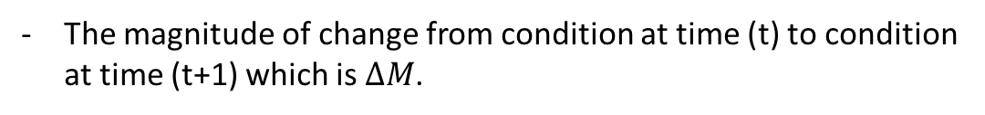



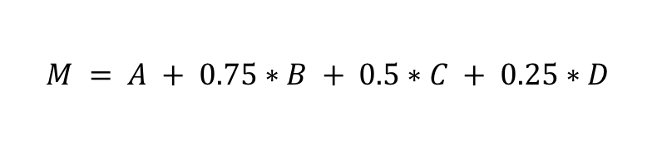
Introduction
Quick Recap
• Prediction Model
• Covariates Selection
The covariates are:
DJMA, Age, Delta Year, Condition at ($M_{t}$) and Material (Wood, Steel and Concrete)
Condition
100
$$M_{(t)}$$
• Predictor Parameter
$$M_{(t+1)}$$
The magnitude of change from condition at time (t) to condition at time (t+1) which is $∆M$.
$${∆M}_{(t+1)}$$
$$M = A + 0.75∗B + 0.5∗C + 0.25∗D$$
Whereby A, B, C and D represent the percentages of excellent, good, damaged and seriously damaged volume respectively in an element
0
2014
2016
2018
Year

Slide 4
Introduction
Quick Recap
• GP Prediction Results with biased sampling and replication

Slide 5

Introduction
Recap
Approach Efficiency
• Prediction model efficiency in solving for SHM
• Advantages of using GP prediction model:
Predicting the values with confidence interval.
Using the bridge characteristics (i.e. Age, DJMA.. Etc.) to provide predictions.
Acceptable accuracy.
• Approach Shortages
Doesn’t provide information for at which speed and acceleration the state change over time.
Doesn’t factor observation uncertainty or specifically uncertainty for (Inspector variability).
$$∆M$$

Slide 6
Objective
• Objective
Build a prediction framework that:
Provide prediction for the speed and acceleration at which the state changes.
Take into consideration the observation uncertainty (predictor uncertainty).
Notes:
This framework would provide a _ forecasts for each element

Slide 7
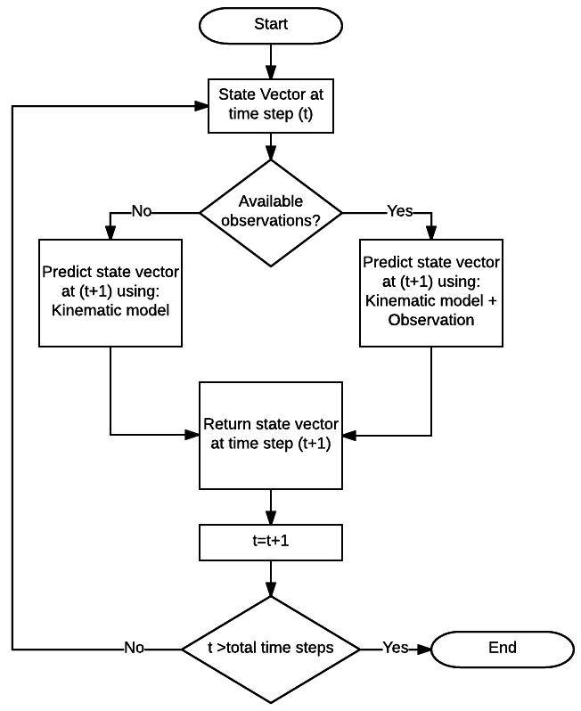
Methodology
Kalman Filter (KF)
• Kalman Filter (KF)
KF: is a popular prediction framework for SHM and time series problems.
KF can be summarized in the following flowchart:
Notes:
This framework would provide a _ forecasts for each element

Slide 8
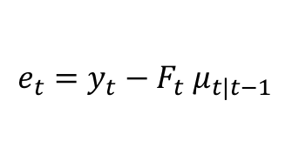
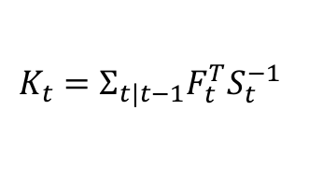
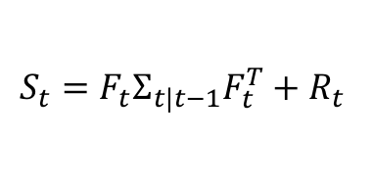
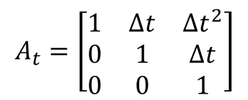
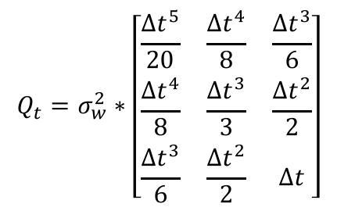

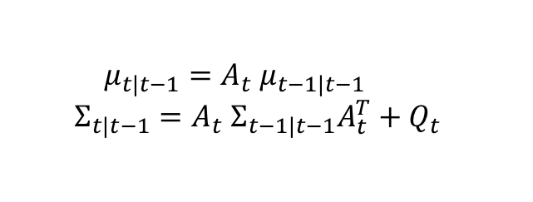

Methodology
Kalman Filter (KF)
• Kalman Filter
Kalman Filter equations:
Kinematic model:
$${μ_{t|t−1}=A_{t} μ}_{t−1|t−1}$$
$${Σ_{t|t−1}=A_{t} Σ}_{t−1|t−1}A_{t}^{T}+Q_{t}$$
Update Kinematic model with observations:
$${μ_{t|t}= μ}_{t|t−1}+K_{t}e_{t}$$
$$Σ_{t|t}=(I−K_{t}F_{t})Σ_{t|t−1}$$
Whereby:
$${e_{t}=y_{t}−F_{t} μ}_{t|t−1}$$
$$Q_{t}=σ_{w}^{2}∗\left[\begin{matrix}\frac{∆t^{5}}{20} & \frac{∆t^{4}}{8} & \frac{∆t^{3}}{6} \\ \frac{∆t^{4}}{8} & \frac{∆t^{3}}{3} & \frac{∆t^{2}}{2} \\ \frac{∆t^{3}}{6} & \frac{∆t^{2}}{2} & ∆t\end{matrix}\right]$$
$$K_{t}=Σ_{t|t−1}F_{t}^{T}S_{t}^{−1}$$
$$A_{t}=\left[\begin{matrix}1 & ∆t & ∆t^{2} \\ 0 & 1 & ∆t \\ 0 & 0 & 1\end{matrix}\right]$$
$$S_{t}={F_{t}Σ}_{t|t−1}F_{t}^{T}+R_{t}$$
$$R_{t}=σ_{v}^{2}$$
Notes:
This framework would provide a _ forecasts for each element

Slide 9




Methodology
KF
Application
$$σ_{w}$$
$$σ_{v}$$
• Finding the right parameters and :
Finding the right parameters for a single structural element is done through maximizing the log-likelihood for the observations of that element:
$$loglikelihood\left(y_{t} | y_{t−1},θ\right) ; θ=\left[σ_{w},σ_{v}\right]$$
Therefore, finding the right parameters for a group of structural elements can be done by maximizing the sum of log-likelihood for all elements:
$$Σ_{1}^{n}loglikelihood\left(y_{t} | y_{t−1},θ\right) \\ θ=\left[σ_{w},σ_{v}\right], \\ n: total numnber of elements$$

Slide 10

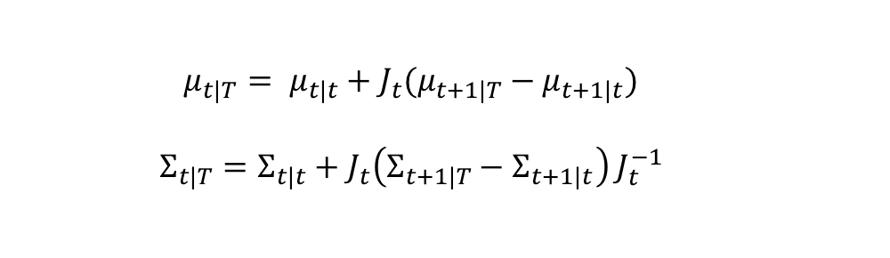
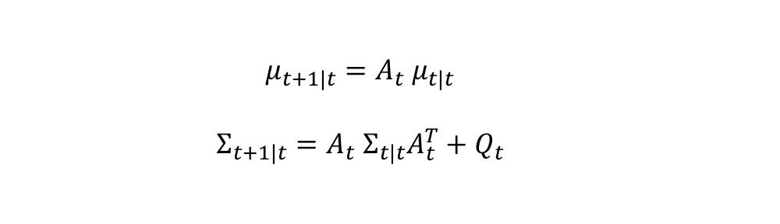
Methodology
KF
Application
• The initial state:
Since the number of observations per-element is too low, the KF model will be highly sensitive to each state value in the time series. Therefore, an acceptable estimation for the initial state is necessary.
• Kalman Smoother:
The Kalman smoother can be summarized in the following equations:
$${μ_{t+1|t}=A_{t} μ}_{t|t}$$
$${Σ_{t+1|t}=A_{t} Σ}_{t|t}A_{t}^{T}+Q_{t}$$
$${J_{t}=Σ}_{t|t}A_{t+1}^{T}Σ_{t+1|t}^{−1}$$
$${μ_{t|T}= μ}_{t|t}+J_{t}(μ_{t+1|T}−μ_{t+1|t})$$
$${Σ_{t|T}=Σ}_{t|t}+J_{t}\left(Σ_{t+1|T}−Σ_{t+1|t}\right){ J}_{t}^{−1}$$

Slide 11
Methodology
KF
Application
• The Full System:
Forward Kalman Filter – Kalman Smoother – Forward Kalman Filter.
KF
SF
KF

Slide 12
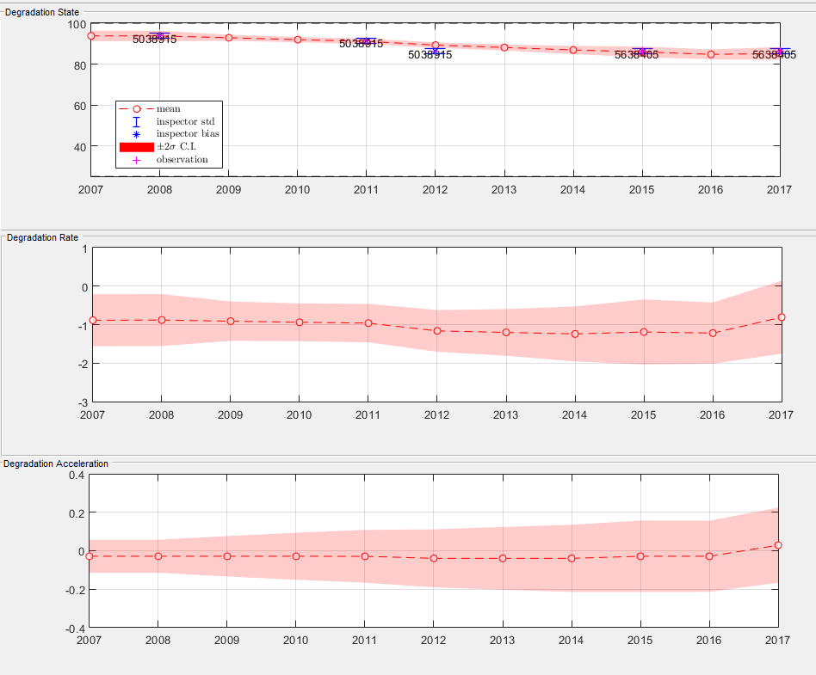
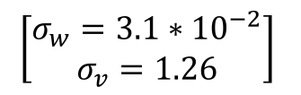
Methodology
KF
Application
• Results:
Element with low variability in the observations.
Structure ID: 00002
$$\left[\begin{aligned}σ_{w}=3.1∗{10}^{−2} \\ σ_{v}=1.26\end{aligned}\right]$$

Slide 13
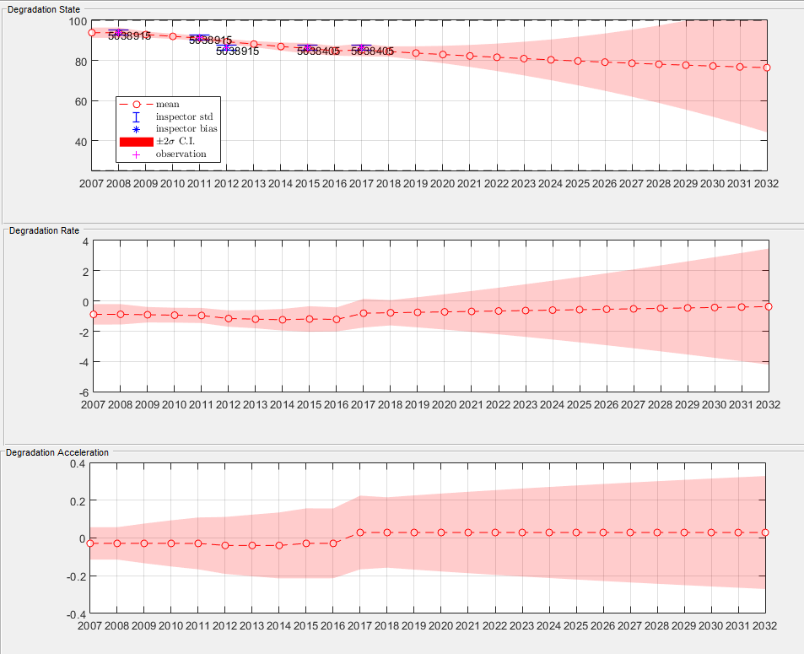
Methodology
KF
Application
• Results:
Element with low variability in the observations (15 years forecast).
Structure ID: 00002
$$\left[\begin{aligned}σ_{w}=3.1∗{10}^{−2} \\ σ_{v}=1.26\end{aligned}\right]$$

Slide 14
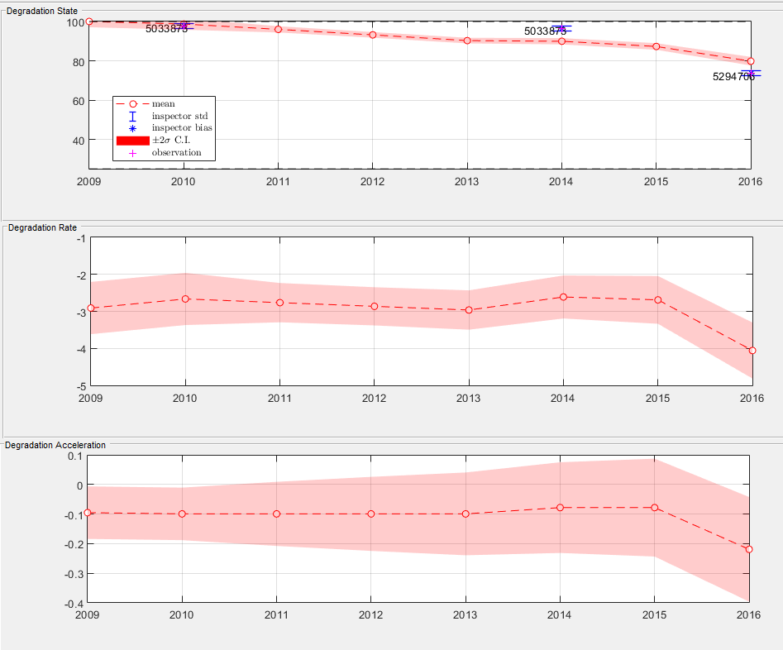
Methodology
KF
Application
• Results:
Element with high variability in the observations.
Structure ID: 01425
$$\left[\begin{aligned}σ_{w}=3.1∗{10}^{−2} \\ σ_{v}=1.26\end{aligned}\right]$$

Slide 15
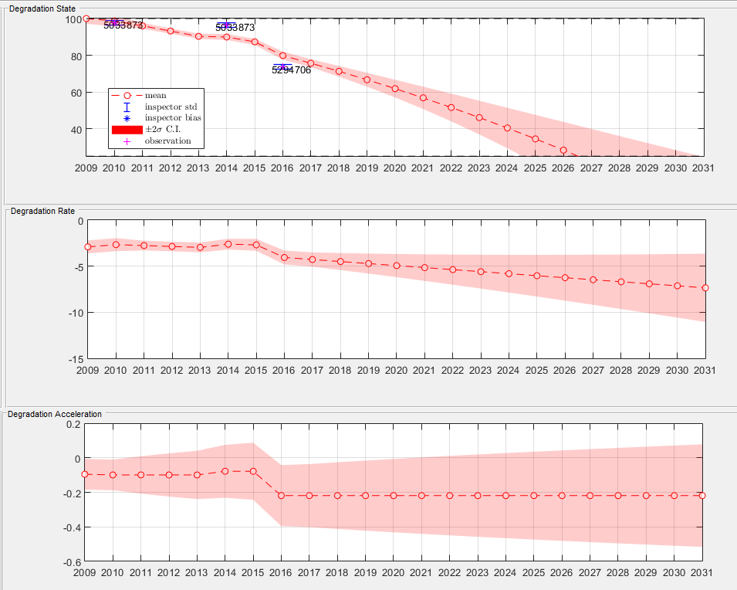
Methodology
KF
Application
• Results:
Element with high variability in the observations (15 years forecast).
Structure ID: 01425
$$\left[\begin{aligned}σ_{w}=3.1∗{10}^{−2} \\ σ_{v}=1.26\end{aligned}\right]$$

Slide 16
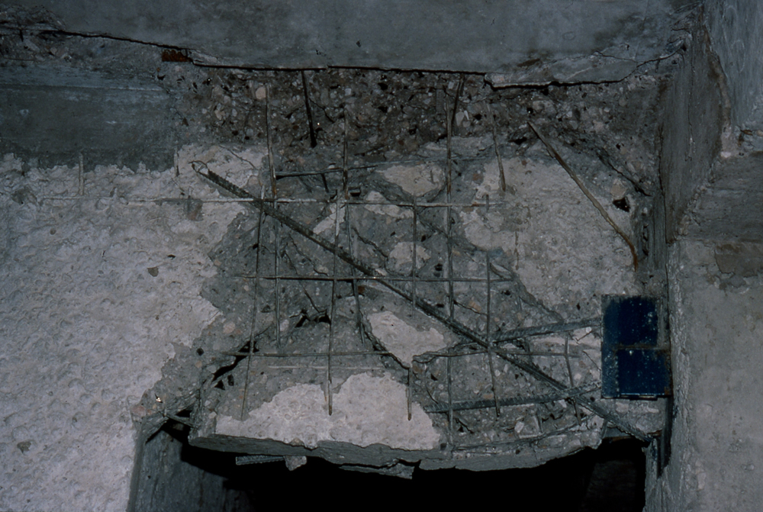
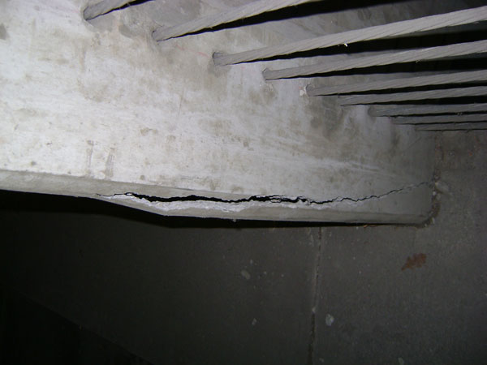
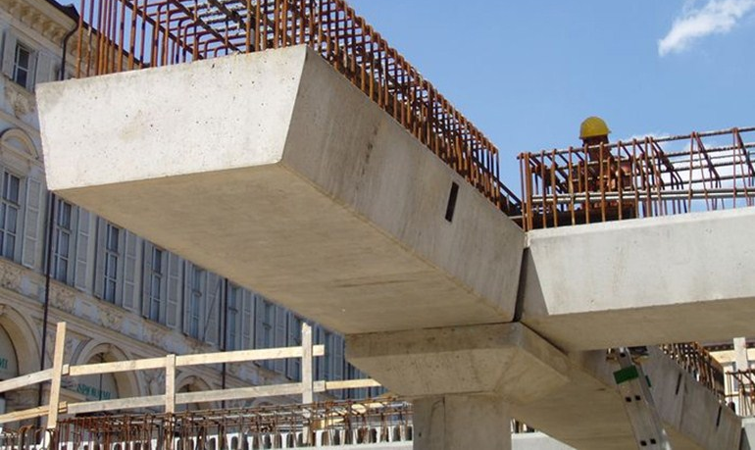
Methodology
KF
App.
Modeling Uncertainty
• Modeling Uncertainty:
A practical point of view for uncertainty:
1
2
3
Seriously damaged
0
50
100
Perfect Condition
Sources: 1: http://db.concretecoalition.org/building/102
2: http://kcwardco.com/wp-content/gallery/jordan-commons-larry-h-mller-office-tower/DSC01263.jpg
3:http://www.archiproducts.com/en/products/ape/reinforced-concrete-beam-for-bridge-trave_14561
Notes:
Damaged: http://db.concretecoalition.org/building/102
Half: http://kcwardco.com/wp-content/gallery/jordan-commons-larry-h-mller-office-tower/DSC01263.jpg
Good:http://www.archiproducts.com/en/products/ape/reinforced-concrete-beam-for-bridge-trave_14561

Slide 17

Methodology
KF
App.
Modeling Uncertainty
• Modeling Uncertainty:
The model proposed:
$$σ_{v}=n_{v}∗(−{\left(M−62.5\right)}^{2}+1406.25)+1$$
$$σ_{w}=n_{w}∗\left(−{\left(M−62.5\right)}^{2}+1406.25\right){+10}^{−6}$$
Whereby n is a hyper parameter to tuned through maximizing the log-likelihood.
M%
$$σ_{v}$$

Slide 18
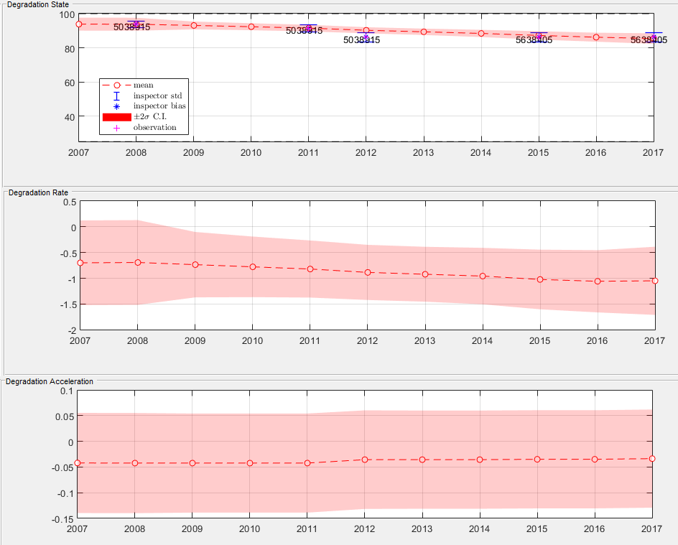
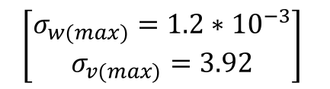
Methodology
KF
APP.
Uncertainty
Results
• Framework Results
Element with no variability in the observations.
Structure ID: 00002
$$\left[\begin{aligned}σ_{w(max)}=1.2∗{10}^{−3} \\ σ_{v(max)}=3.92\end{aligned}\right]$$

Slide 19
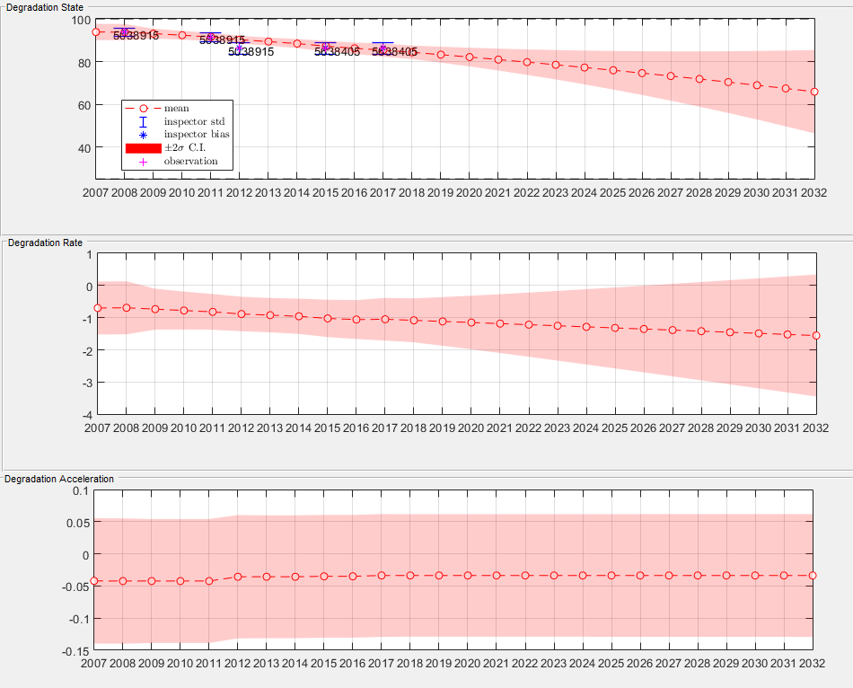
Methodology
KF
APP.
Uncertainty
Results
• Framework Results
Element with no variability in the observations (15 years forecast).
Structure ID: 00002
$$\left[\begin{aligned}σ_{w(max)}=1.2∗{10}^{−3} \\ σ_{v(max)}=3.92\end{aligned}\right]$$

Slide 20
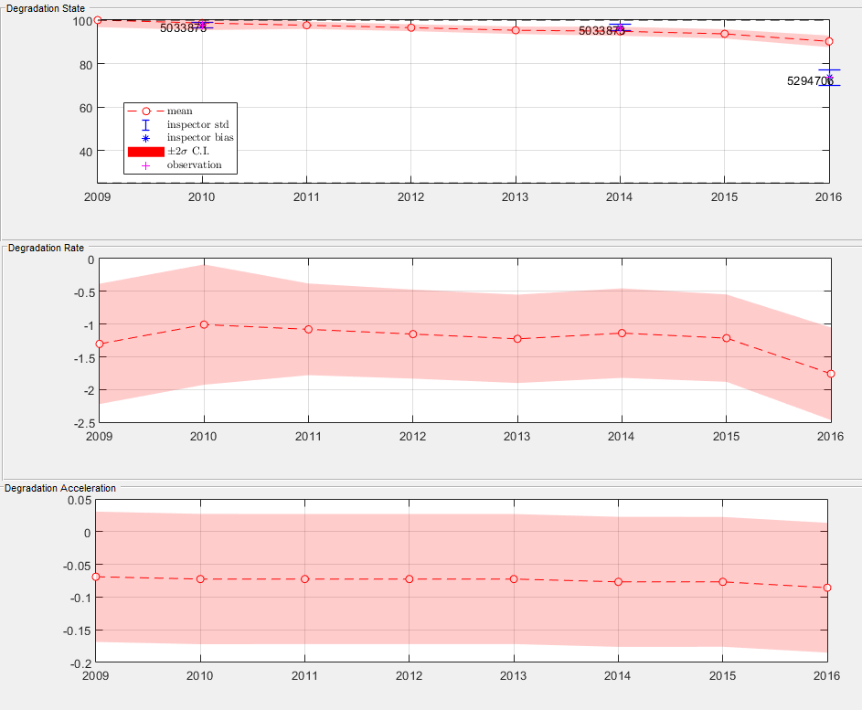
Methodology
KF
APP.
Uncertainty
Results
• Framework Results
Element with variability in the observations.
Structure ID: 01425
$$\left[\begin{aligned}σ_{w(max)}=1.2∗{10}^{−3} \\ σ_{v(max)}=3.92\end{aligned}\right]$$

Slide 21
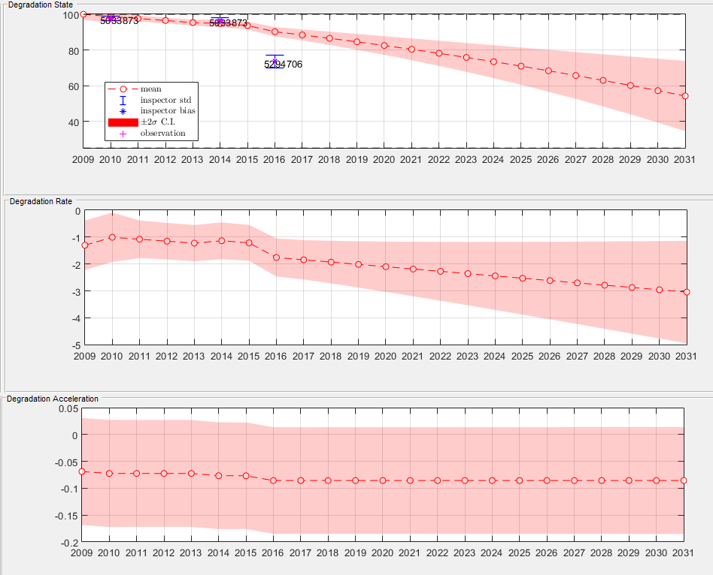
Methodology
KF
APP.
Uncertainty
Results
• Framework Results
Element with no variability in the observations (15 years forecast).
Structure ID: 01425
$$\left[\begin{aligned}σ_{w(max)}=1.2∗{10}^{−3} \\ σ_{v(max)}=3.92\end{aligned}\right]$$

Slide 22
Conclusion
• Summary
The Kalman Filter can be used for cases with low number of observations, however, it needs to be tuned well.
Factoring more knowledge can always help improve prediction models behavior.
• Future Considerations
Assessing the behavior of KF in transformed space.
Constraining the Klaman Filter.
Fusing the Kalman Filter with GP.
Notes:
This framework would provide a _ forecasts for each element

